Slide 1
Neural Net Report
Your Name: Devin Fromond
Your GT Username: dfromond3

Slide 2
Question 5: Learning With Restarts
testPenData:
Max accuracy: 0.9073756432246999
Average accuracy: 0.9012006861063465
Standard deviation: 0.007332301818881595
testCarData:
Max accuracy: 0.985
Average accuracy: 0.981
Standard deviation: 0.0037416573867739447

Slide 3
Question 6: Varying the Hidden Layers
Statistic table for testPenData – report the max, average, and standard deviation at various amount of perceptrons.
 | Number of Perceptrons at the Hidden Layer
 | 0 | 5 | 10 | 15 | 20 | 25 | 30 | 35 | 40
Max Accuracy | 0.000000 | 0.856204 | 0.892224 | 0.903373 | 0.908805 | 0.909377 | 0.940537 | 0.908519 | 0.907947
Avg Accuracy | 0.000000 | 0.840652 | 0.887421 | 0.897999 | 0.902802 | 0.902459 | 0.912007 | 0.898571 | 0.900915
Standard Deviation | 0.000000 | 0.014712 | 0.006233 | 0.005918 | 0.005152 | 0.008022 | 0.014345 | 0.008221 | 0.005211

Slide 4
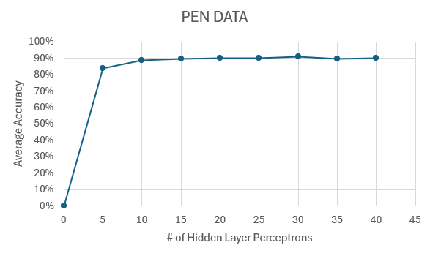
Question 6: Varying the Hidden Layers
Create a learning curve for testPenData where the number of hidden layer perceptrons is the independent variable and the average accuracy is the dependent variable.

Slide 5
Question 6: Varying the Hidden Layers
For testPenData, discuss any notable trends you saw related to increasing the size of the hidden layers in your neural net.
Answer: TestPenData started off at 0% average accuracy with no hidden layers and grew dramatically from 0 → 5 hidden layers. However, as the number of hidden layers increases past 10, there is not a significant improvement in the average accuracy. The graph demonstrates the turbulence in the data, as illustrated by the very slight rising and falling of the average accuracy.

Slide 6
Question 6: Varying the Hidden Layers
Statistic table for testCarData – report the max, average, and standard deviation at various amount of perceptrons.
 | Number of Perceptrons at the Hidden Layer
 | 0 | 5 | 10 | 15 | 20 | 25 | 30 | 35 | 40
Max Accuracy | 0.615 | 0.990000 | 0.985000 | 0.970000 | 0.965000 | 0.970000 | 0.990000 | 0.965000 | 0.965000
Avg Accuracy | 0.615 | 0.962000 | 0.976000 | 0.960000 | 0.961000 | 0.963000 | 0.966000 | 0.957000 | 0.958000
Standard Deviation | 0.000000 | 0.016310 | 0.008602 | 0.007071 | 0.005831 | 0.006000 | 0.018547 | 0.005099 | 0.005099

Slide 7
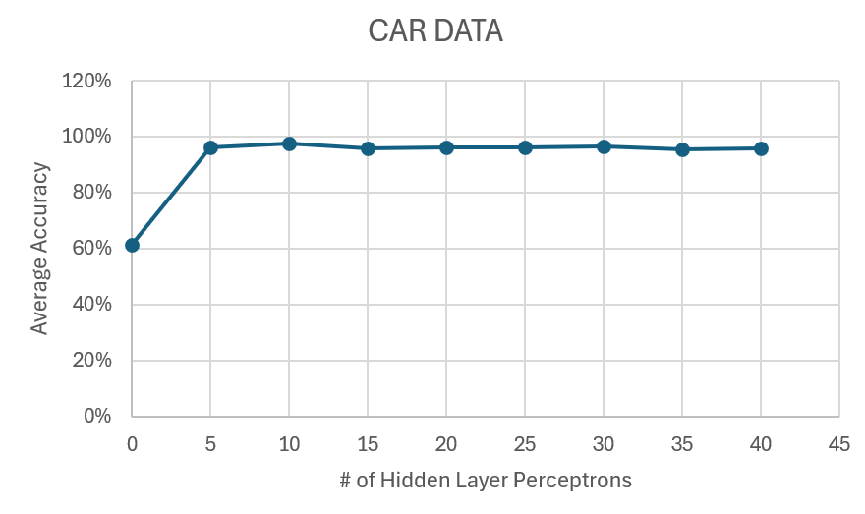
Question 6: Varying the Hidden Layers
Create a learning curve for testCarData where the number of hidden layer perceptrons is the independent variable and the average accuracy is the dependent variable.

Slide 8
Question 6: Varying the Hidden Layers
For testCarData, discuss any notable trends you saw related to increasing the size of the hidden layers in your neural net.
Answer: Similarly to testPenData, we find the average increased the greatest with from 0 → 5 permutations. However, no hidden layer did not result in the average accuracy being 0, which was the primary difference between the two datum. Furthermore, we still see a turbulence effect, however, the range of such is less than that of PenData and the average accuracy seems to be higher compared to PenData.

Slide 9
Question 7 (extra credit): Learning XOR
Report the max accuracy, average accuracy, and standard deviation of the neural net that you have trained with 1) no hidden layer, and 2) a hidden layer with various amount of perceptrons (at least 3 different amounts)
 | No Hidden Layer | Hidden Layer
 |  | 5 perceptrons | 10 perceptrons | 15 perceptrons
Max Accuracy | 0.5 | 0.5 | 0.75 | 0.75
Avg Accuracy | 0.3 | 0.3 | 0.5 | 0.6
Standard Deviation | 0.244948 | 0.1 | 0.15811 | 0.2

Slide 10
Question 7 (extra credit): Learning XOR
Report the behavior of the trained neural net without a hidden layer.
Answer: No hidden layer results in a low average accuracy of 0.3. This is to be expected since a neural network without a hidden layer can only model linearly separable function (only linear relationships). Overall, the performance is poor as a result of it not fitting the non-linear nature of XOR.

Slide 11
Question 7 (extra credit): Learning XOR
Report the behavior of the trained neural net with a hidden layer. Are the results what you expected? Explain your observation.
Answer: The behavior is better and follows what was expected, with increasing perceptions and number of neutrons in the hidden layer corresponding to a greater accuracy. The greater the neutrons, the more connections are able to be made. I did not, however, expect to need 48 neutrons/perceptions to reach 100% accuracy. When learning rate is increased, though, the number of necessary neutrons falls considerably.

Slide 12
Question 8 (extra credit): Novel Dataset
List the name and the source of the dataset that you’ve chosen.
Name: ______
Source (e.g., URLs): ______
Briefly describe the dataset: _____

Slide 13
Question 8 (extra credit): Run Stats
Max accuracy: _______
Average accuracy: _______
Standard deviation: ________

Slide 14
Question 8 (extra credit): Novel Dataset
Describe how to run the code that you’ve set up to train the selected dataset.
Answer:

